Slide 1
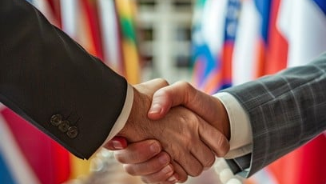
Global Leadership Profile
Dr. Shaziya
Tashnem Siddiqui
Global Peace Ambassador | International Human Rights Advocate
Elite Business Consultant | Leadership & Policy Strategist
Founder & President
+918299804011
Dr. Shaziya International Groups
drshaziyainternationalgroups@gmail.com

Slide 2
About
Executive Profile
Dr. Shaziya Tashnem Siddiqui is an internationally recognized humanitarian leader, peace diplomat, and global strategic advisor, known for her contributions to human rights advocacy , women and youth empowerment , leadership development , and international institutional collaboration .
Recognition Areas
Peace Leadership
Global peacebuilding initiatives
Philosophy
Ethical leadership frameworks
With a distinguished presence across global diplomatic, humanitarian, and business platforms, she has emerged as a dynamic representative of ethical leadership, inclusive development, and cross-border cooperation.
Philanthropy
Humanitarian service excellence
Social Reform
Her work bridges governments, international councils, entrepreneurs, and humanitarian institutions to promote sustainable global progress.
Community development impact
Economic Empowerment
Global trade & business development
35+
400+
Born: 11 October 1993 | Kanpur, Uttar Pradesh, India
Honorary Doctorates
International Awards
Academic Qualifications: B.A. | M.A. | MBA

Slide 3
Founder & President
Dr. Shaziya International Groups
A distinguished international platform connecting global stakeholders for sustainable development
Six Core Mission Areas
135+
1
Global Peacebuilding
2
Human Rights Diplomacy
Initiatives promoting international harmony
Advocacy for universal human dignity
Countries
3
Women & Youth Leadership
4
Education Collaboration
Active global operations spanning six continents
Development programs for next generation
Cross-border academic partnerships
5
Trade & Economic Empowerment
6
Humanitarian Relief
Business development across borders
Institutional partnerships for aid delivery
Visionary Leadership: Under Dr. Shaziya's guidance, the organization advances sustainable development and inclusive global growth .
Diplomatic Bridge
Connecting policymakers, organizations & business leaders

Slide 4
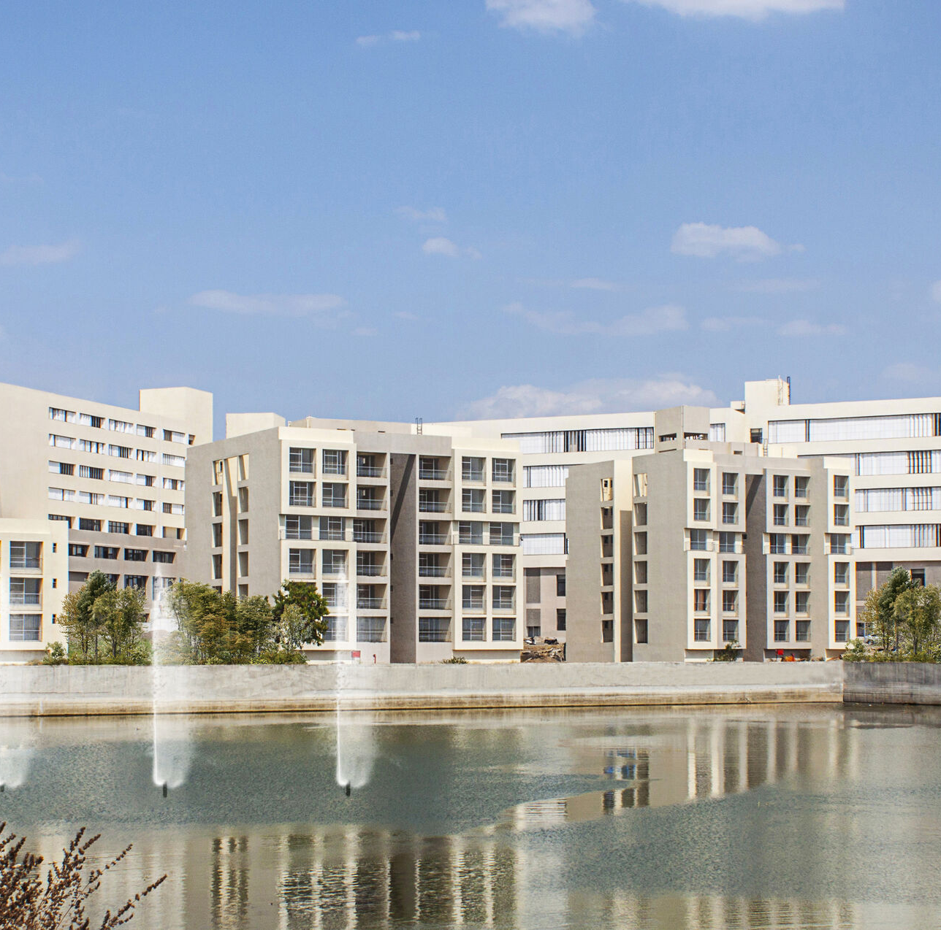
Institutional Legacy
National Recognition
Medical College
Maharashtra, India
In recognition of her lifelong dedication to humanitarian service and social development, a medical college is being established in her honor in the state of Maharashtra, India.
Healthcare Access
Strengthening medical services for communities
Medical Education
Training the next generation of healthcare professionals
∞
Community Development
Long-term public welfare initiative
Lasting Impact
A permanent testament to humanitarian excellence, creating generational change through education and healthcare.
This institution symbolizes national appreciation for her contribution to society.

Slide 5
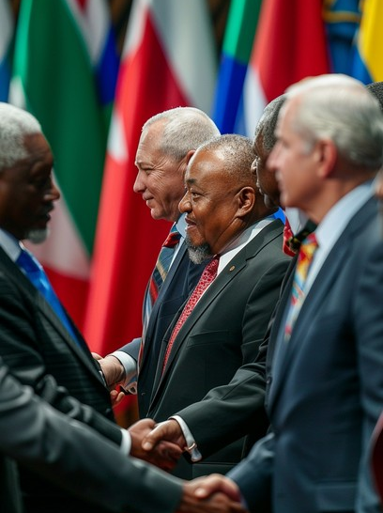
International Appointments
United Nations & Global Diplomacy
Executive Member
United Nations Foundation
Strategic leadership in UN initiatives and global policy development
Global Peace Ambassador
UN Peace Keeping Rescue Mission
Diplomatic representation for international peacekeeping operations
World Committee Member
World Peace Mission and Human Rights Academy
Governance role in global peace and human rights education
UN Framework
Active participation in United Nations initiatives and global diplomatic missions advancing peace and human rights.
Advisory Board Member (Asia)
World Humanity Commission
Regional advisory leadership for humanitarian initiatives across Asia

Slide 6
International Appointments
Peace & Development Councils
Board Member
World Committee Member
World Committee Member
World Committee
Advocacy & Tolerance
Trade & Commerce
General International Council for Peace and Development – Governance role in international peace initiatives and sustainable development frameworks.
World Academy of Advocates of Tolerance and Peaceful Coexistence – Promoting intercultural dialogue and peaceful conflict resolution globally.
Global Chamber of Trade, Business & Commerce – Strategic leadership in international trade development and economic cooperation.
Global scope
Intercultural focus
Economic focus
Strategic Impact
These appointments reflect Dr. Shaziya's expertise in peace diplomacy, human rights advocacy, and international economic development—positioning her as a key voice in global governance.

Slide 7
International Appointments
Education, Sports & Business Networks
Vice President
Project Director
Women's Committee
Asia Representative
IOF International Olympic Federation
American International Education Federation
Leadership role advancing women's participation in international sports and athletic diplomacy.
Directing educational initiatives and institutional partnerships across Asian markets.
Sports diplomacy & gender equity
International education collaboration
Country Representative
Lender Group Owner
Executive Member
Microfinance
Commonwealth Entrepreneurs Club
Kiva
Representing entrepreneurial interests and business development within Commonwealth nations.
Leading microfinance initiatives supporting entrepreneurs and small businesses globally through crowdfunding.
Commonwealth business networks
Economic empowerment & microfinance

Slide 8
International Appointments
Regional & Specialized Roles
National Leadership
Advisory Board Member
European Council For Islamic Centres
State Convenor
Advisory leadership for Islamic cultural and community centers across Europe
Women's Committee
National Front of Indian Trade Unions (DHN)
Former Joint Secretary
Film Welfare Association
Panelist – Global Women's Leadership
Women's Of Era
Former State Head Team
Expert panel participation in global women's leadership dialogues and initiatives
Uttar Pradesh
HBN News
Global Impact Team Member
The Presidential Culinary Museum and Presidential Service Center
Additional
90+
Contributing to presidential heritage and service initiatives
Appointments

Slide 9
Core Competencies
Areas of Global Expertise
Peace Diplomacy
Human Rights Advocacy
Women & Youth Empowerment
Institutional Strategy
Conflict resolution & international mediation
Universal dignity & justice promotion
Leadership development programs
International organization governance
Leadership Coaching
Global Business Consulting
Cross-Border Trade
Humanitarian Programs
Policy advisory & executive mentoring
Strategic advisory for international markets
International commerce development
Relief & development initiatives
Integrated Expertise: Dr. Shaziya combines these eight domains to deliver comprehensive solutions for global challenges.

Slide 10
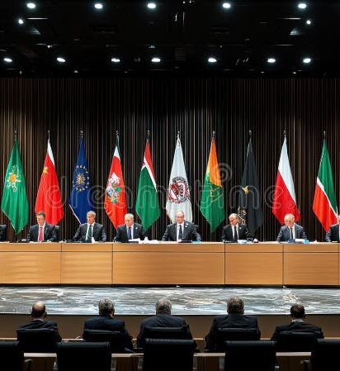
Diplomatic Participation
International Forums & Leadership Programs
Best Diplomat Programs
Participation in elite diplomatic training and recognition programs that cultivate international leadership excellence.
Global Engagement
Active participation in prestigious international forums, competitions, and leadership programs associated with the United Nations framework.
International Policy Dialogues
Engagement in high-level discussions on global governance, sustainable development, and multilateral cooperation.
Best diplomat programs
International policy dialogues
Multilateral Leadership Engagements
Multilateral leadership engagements
Active involvement in collaborative leadership initiatives across international organizations and diplomatic missions.
Standing in Global Governance: These engagements reflect Dr. Shaziya's strong position in international diplomacy and her commitment to shaping global policy.

Slide 11

Leadership Philosophy
A New Generation of Global Leadership
Dr. Shaziya represents a new generation of globally engaged leadership —rooted in diplomacy , humanitarian ethics , strategic governance , and inclusive economic advancement .
Her institutional affiliations, global honors, and policy-oriented initiatives reflect a commitment to long-term international cooperation and sustainable human development .
Diplomatic Excellence
Humanitarian Ethics
Building bridges across nations and cultures
Championing dignity and human rights
"Leadership is not about being in charge. It's about taking care of those in your charge."
— Simon Sinek
Strategic Governance
Economic Inclusion
Dr. Shaziya embodies this philosophy through service-oriented leadership that prioritizes human welfare and collective progress.
Shaping policy for sustainable progress
Advancing equitable global trade

Slide 12

Connect for Global Impact
Partner with a leader shaping the future of international diplomacy and humanitarian progress
Dr. Shaziya Tashnem Siddiqui
Founder & President – Dr. Shaziya International Groups
Phone
Email
+918299804011
drshaziyainternationalgroups@gmail.com
135+ Countries
400+ Awards
35+ Doctorates
90+ Appointments

